Slide 1
ScoreSense
Goal Line Detection using RFID
Teddy & Kendall
Notes:
Radio frequency identification
Focus on sports in prior presentations
Wanted to focus on soccer as we found a clear area of interest that needs fixing
Goal line detection is when the referees are determining if it was a goal or not
The uncertainty of only using humans leads to incorrect results and an extreme slow down of gaem play

Slide 2
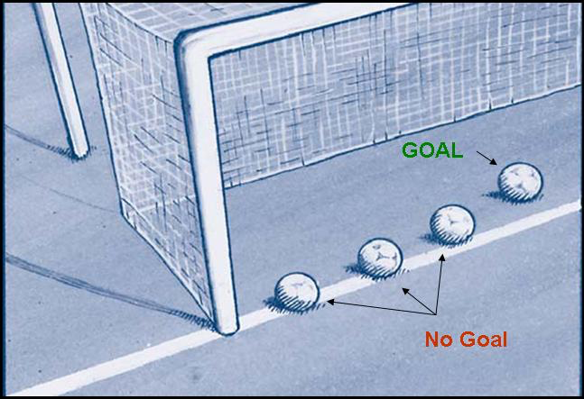
WHAT IS A VALID GOAL?

Slide 3
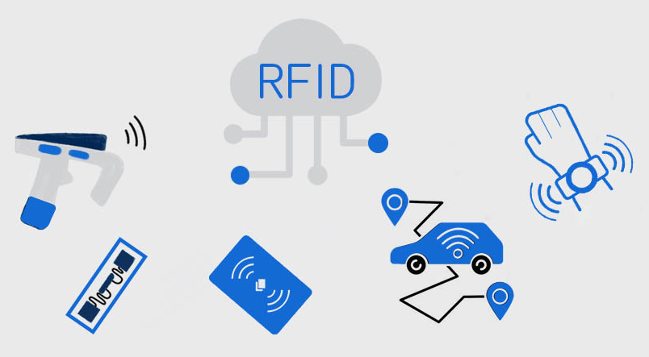
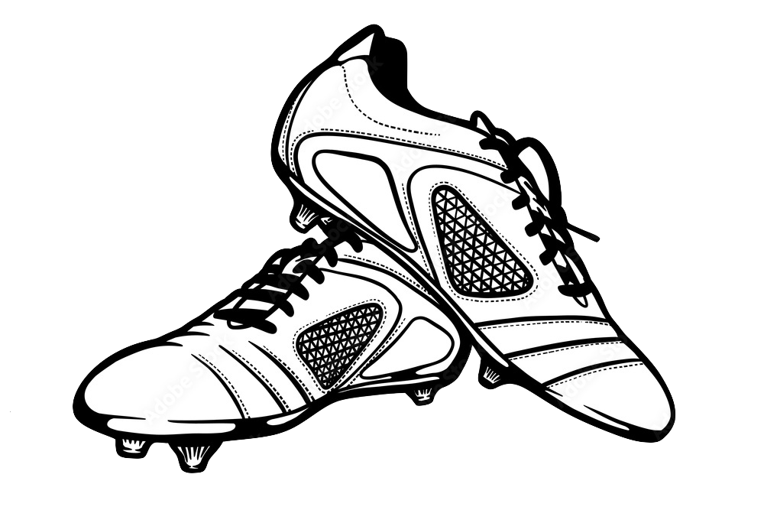
WHAT IS RFID?
RFID Tag
Reader
Object
Radio Waves

Slide 4

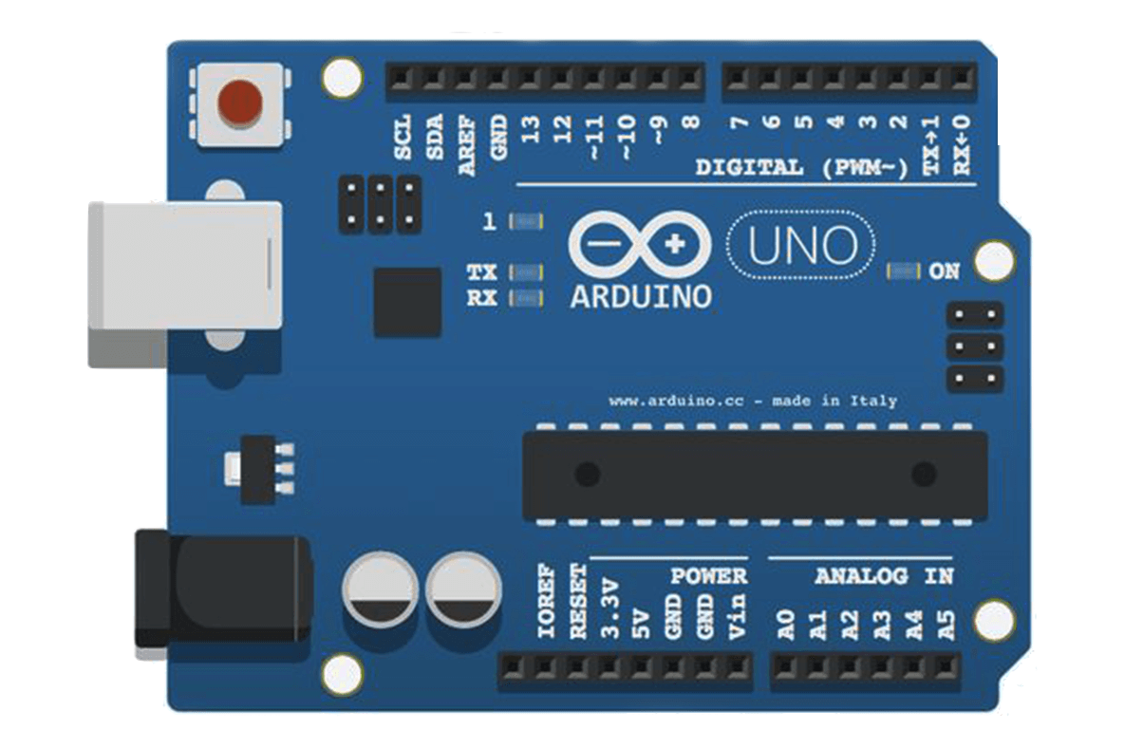
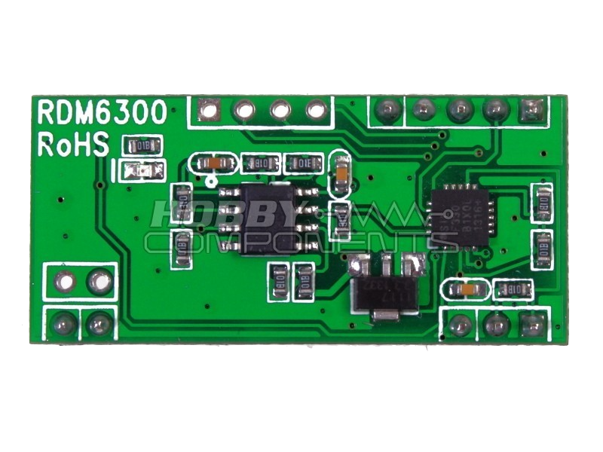
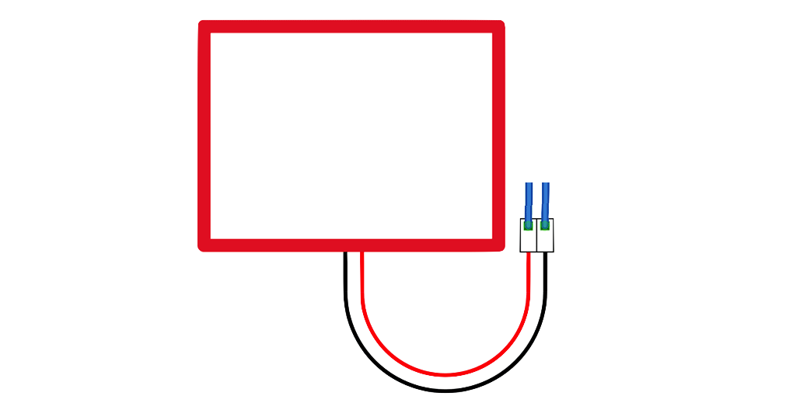
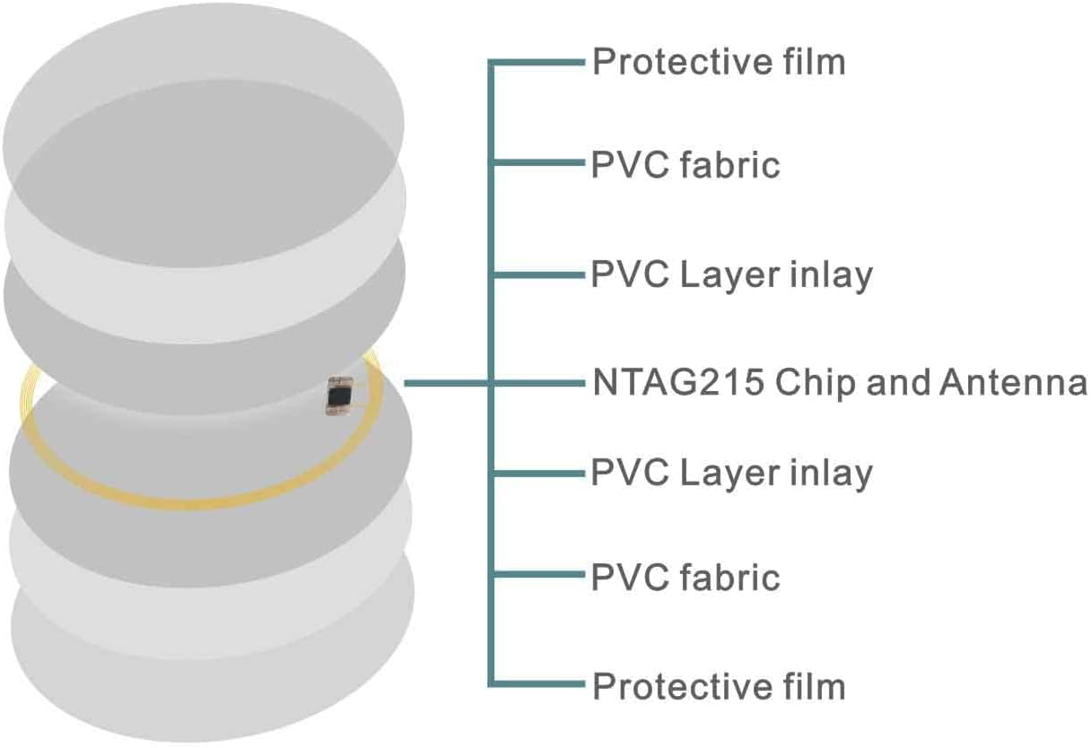
Materials:

Slide 5
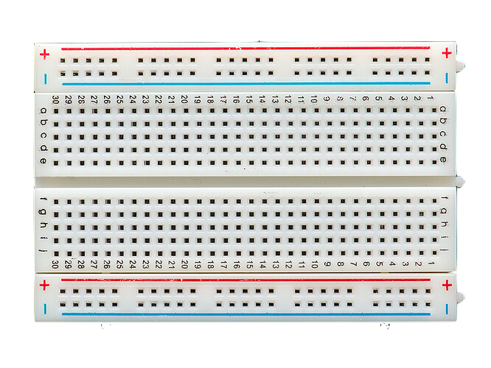





Arduino Uno
RDM6300
Resistor
RFID Coil
LED
Bread Board
Notes:
Kind of talk through code

Slide 6
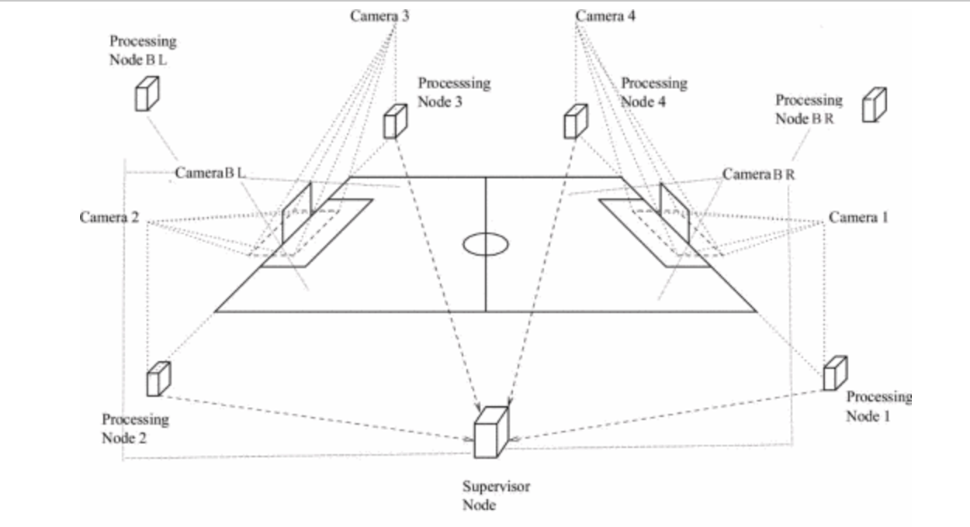
Current Technology
Notes:
3 cameras on each goal → 6 total
Two parallel cameras, one perpendicular
Each camera is connected to a processor → every processor is connected to the main node
Main node uses time space coherence of ball 3D trajectory to determine if goal as been scored
ISSUES
Cameras are not detecting the ball, detecting motion
Can often detect people, towels, water bottles, etc
Also leads to detecting colors → can see color scheme on jersey and mistake it for the ball
Technology like this costs over $260,000 to install in a stadium
The first being Spagnolo et al.’s solution. Spagnolo proposed a solution where candidate ball regions are analyzed to detect the ball. This involves having three cameras recording each goal: two parallel to the goal frame and one perpendicular. All of these processors are then connected to a main node. This main node has a decision making function based on the processing results coming from the cameras. Using the time space coherence of the ball's 3D trajectory, the main node can determine if a goal has been scored.
While this solution does help with the goal line detection issue, it also introduces a world of issues. The cameras used in this technology are very sensitive. This means if there are other objects in the area, such as players, towels, or water bottles, the main node may think a goal has been scored. Also, if a specific color scheme on a jersey is sensed, this may also cause a faulty goal to be called [4].

Slide 7
Spagnolo
Ekin
Cruciani
D’Orazio
Fraunhofer
Anacona
ScoreSense
Notes:
Use of camera, expensive, use of magnetic fields, complex algorithms, accuracy

Slide 8
WHAT ARE THE BENEFITS?
Quicker Game Time Calls
Less Human Error
More Accurate Statistics
Better Viewer Experience
More Reliable Scores
Less Fighting
Notes:
Quicker game time calls -
Better viewer experience
Less human error - do not have to rely on the refs
More reliable scores - getting a goal can really change the momentum of the game, so verifying goals is important
More accurate statistics - for players themselves and for sports bettors
Less Fighting - on the field (with the refs or amongst teams) or in the stands (amongst rivaling fans)

Slide 9
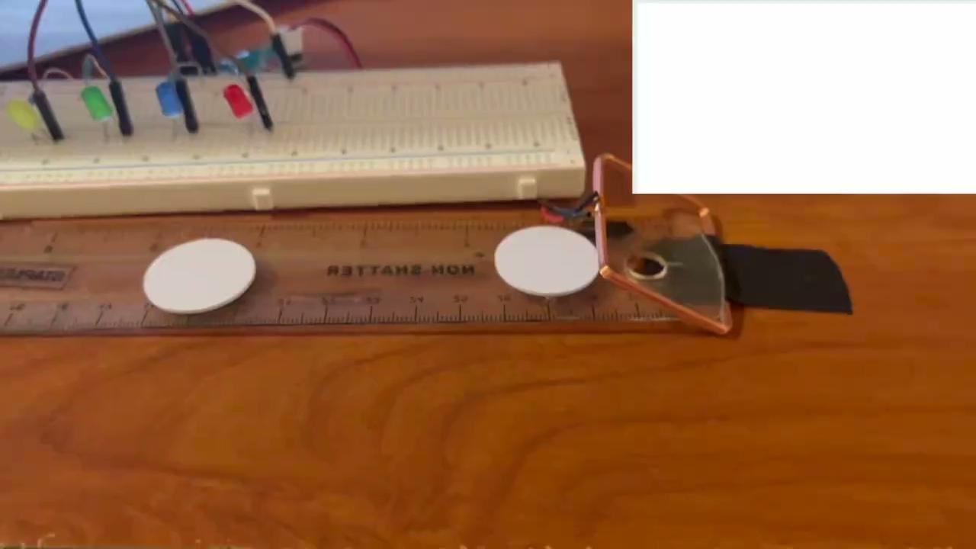

Slide 10
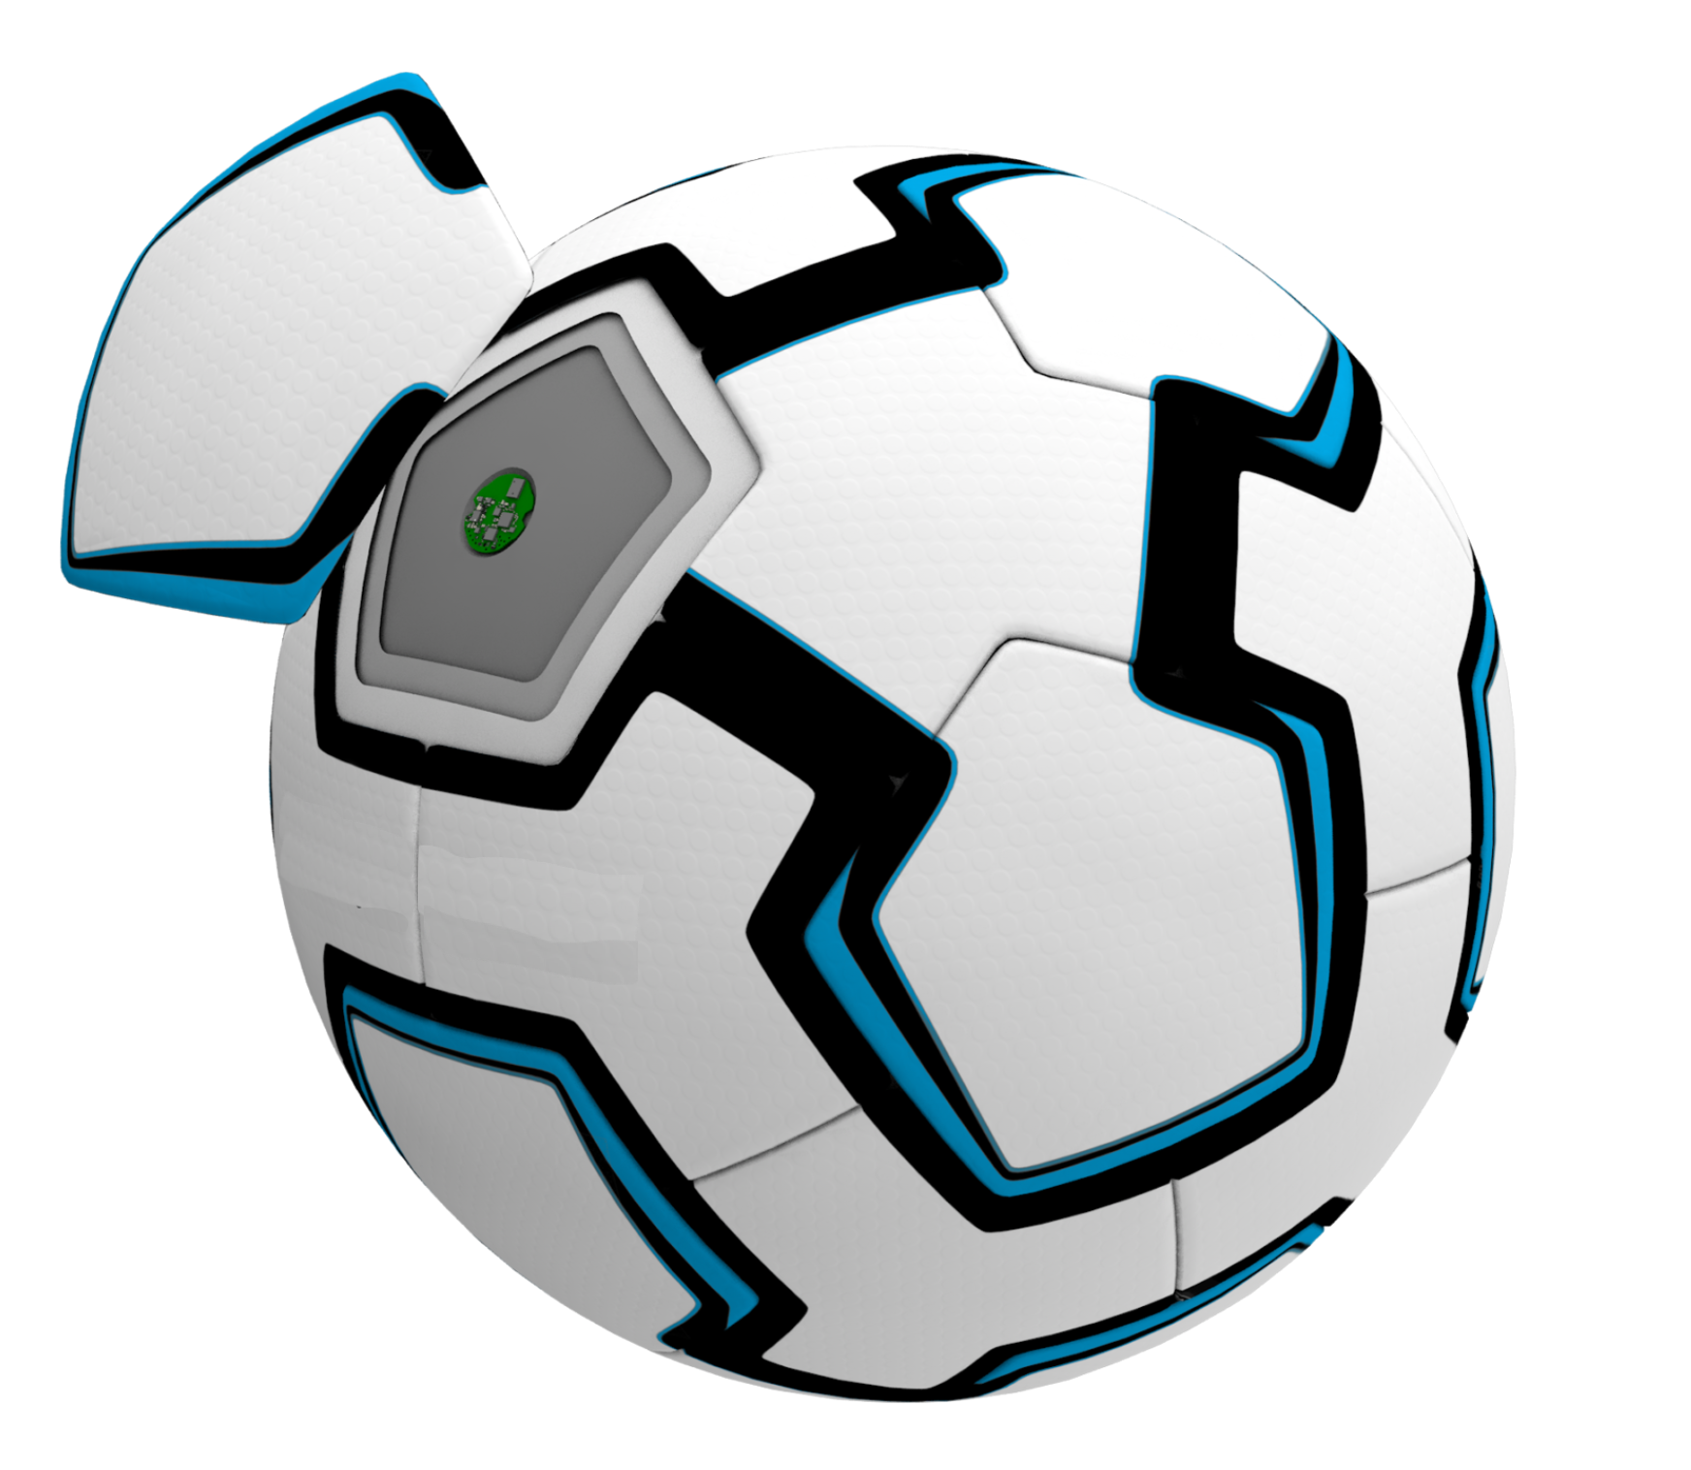
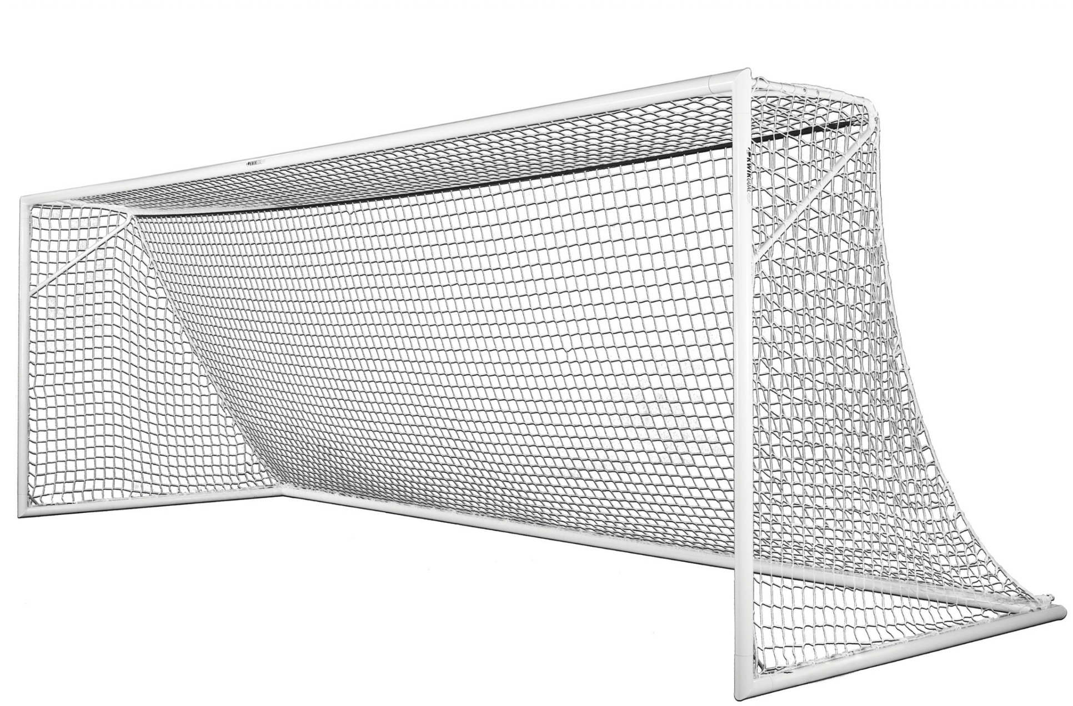
Goal Line

Slide 11
EDGE CASES
Situations that may happen that have unique outcomes:
Ball partially crosses the goal line, and is then pushed through the goal
Ball partially crosses the goal line, and is then pulled back out of the goal

Slide 12
EDGE CASES: ALTERATIONS
ORIGINAL TESTING
THE FIX
No differentiation between tags
Relied on count of tags
Identify each tag individually
As each unique tag crosses the reader, light up LED
When all four LEDs light up, signal valid goal
THE PROBLEM
If ball stops on the line, will scan same tag multiple times
If ball partially crosses and rolls back, will scan tags multiple times
Both result in incorrect goal calls

Slide 13

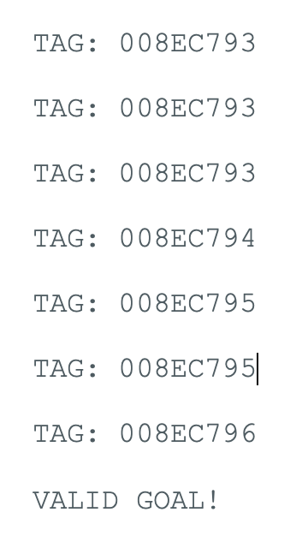
EDGE CASES: OUTPUTS
Ball partially crosses the goal line, and is then pushed through the goal

Slide 14
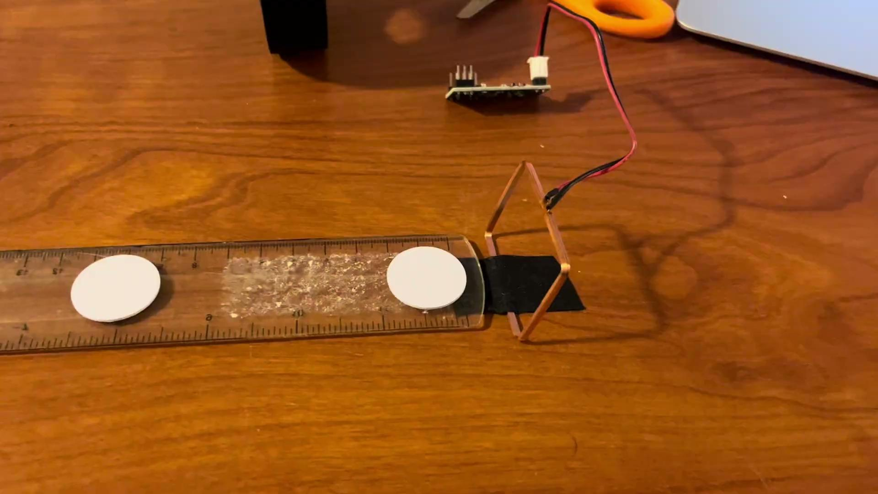
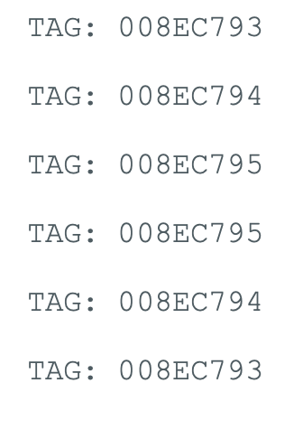
EDGE CASES: OUTPUTS
2. Ball partially crosses the goal line, and is then pulled back out of the goal

Slide 15
FUTURE IMPLEMENTATION
WITHIN SOCCER:
OTHER SPORTS:
Whether the ball as stayed in bounds or not
Whether a player has stepped out of bounds
Adapt to goal rules of other sports (touchdown in football, touching a base in baseball, etc)
Boundary tracking
Amateur leagues

Slide 16
Resources
Esther Lee Rosen, E. L. Y., Holzer, H. J., & Watson, T. (2016, July 28). Sports, jobs, & taxes: Are new stadiums worth the cost?. Brookings. https://www.brookings.edu/articles/sports-jobs-taxes-are-new-stadiums-worth-the-cost/
Publications/Laws. U.S. Futsal. (n.d.). https://www.futsal.org/publications/laws/
McHaney, S. (2014, June 16). Goal-line technology begins to clear controversial goals. PBS. https://www.pbs.org/newshour/world/goalline-technology-begins-clear-controversial-goals
Spagnolo, P., Leo, M., Mazzeo, M., Nitti, N., Stella, E., & Distante, A. (2013). Non-invasive Soccer Goal Line Technology: A Real Case Study. IEEE Conference on Computer Vision and Pattern Recognition Workshops. 10.1109/CVPRW.2013.147.
Ekin, A., Tekalp, A. M., & Mehrotra, R. (July, 2003). Automatic soccer video analysis and summarization. IEEE Transactions on Image Processing. 12(7), 796-807. 10.1109/TIP.2003.812758.
Ghosh, S. et al., (2019). Radio Frequency Identification Based Goal Line Technology for Quick Decision Making in a Football Match. Devices for Integrated Circuit (DevIC). 441-445. 10.1109/DEVIC.2019.8783918
Leveridge, S. (2024, May 2). Why La Liga doesn’t have goal-line technology. Forbes. https://www.forbes.com/sites/samleveridge/2024/04/22/why-doesnt-la-liga-have-goal-line-technology/#
Radio Frequency Identification (RFID): What is it?: Homeland security. U.S. Department of Homeland Security. (n.d.). https://www.dhs.gov/archive/radio-frequency-identification-rfid-what-it#:~:text=Radio%20Frequency%20Identification%20(RFID)%20technology,requiring%20a%20line%20of%20sight

